Slide 1
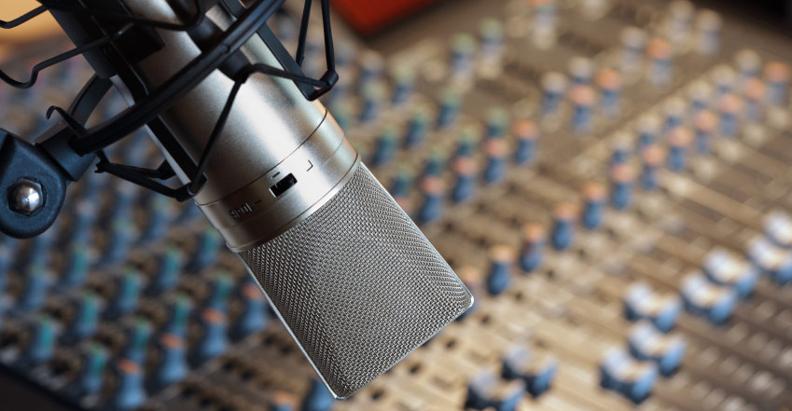

Mo’ Signal Mo’ Betta
MULTI-MICROPHONE DENOISING
Karl Ni
Notes:
Spread out microphones throughout the room
Isolate
Denoise

Slide 2
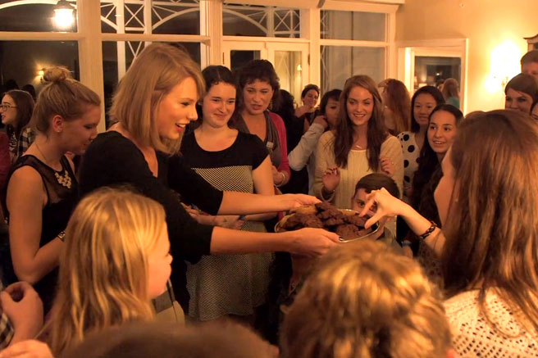
Notes:
Your house sitter had a party while you were gone and someone broke your vase!
Luckily, you’ve placed a lot of microphones around in the room.
You were in a hurry, though, and just threw them out there.
Keypoint: distribute microphones arbitrarily.

Slide 3
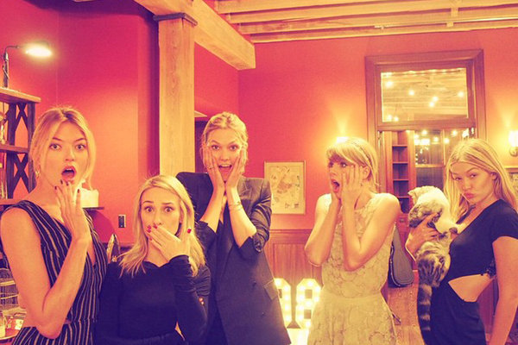

Notes:
2 Things:
- How many people at this party?
- Who broke your vase?

Slide 4

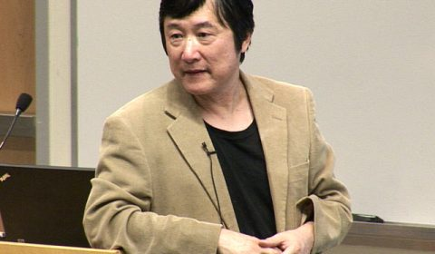


WHY THIS? WHY NOW?
STATE OF THE ART & RELATED WORK
Notes:
Timeline slide
SINGLE SENSOR
HIGH ERROR RATES
PROBLEM UNSOLVED IN 20 YEARS
SENSOR ARRAY
HIGHLY CALIBRATED
KNOWN PLACEMENT
SYNCHRONIZED TIMING
POOR COVERAGE
EXPENSIVE
DSP-BASED
NONLINEAR EFFECTS

Slide 5




WHY SHOULD YOU CARE?
IMPACT AND COLLABORATION
OPERATIONAL
ECONOMIC
MISSION
INDUSTRY
ACADEMIA
Notes:
Talking to PAG and Dave G (after his meetings w/CIA+NSA); their mission = get in, place sensors, get out
Ensuring Safety and Mission Success
Impact
(Operational) PAG: Quick sensor placement & reliable data recovery
(Economic) Cheap COTS alternative that is simple and works
(Mission) Capability in enhances problems in other speech areas
(Community) Lab41 and IQT
MULTIPLE COMPANIES: Denoising from multimicrophone (Vesper).
Two companies. SetemTech
Not credible.

Slide 6
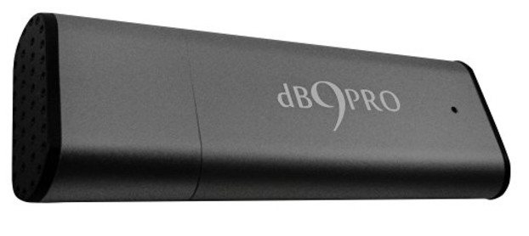
WHAT DO WE NEED?
SPECIFICS AND REQUIREMENTS
10 Amazon microphones $43.29. (Cheaper ones: $16.32)
Two FTE at 9 months
Travel costs
8 offsite campaign
Legal Advisement on Recording
Notes:
Timeline slide

Slide 7






EMAIL
kni@iqt.org
PHONE
650-690-5347
WEBSITE
www.lab41.org
BLOG
www.lab41.org/gab41
Notes:
Contact slide. Feel free to change to suit your needs

Slide 9
Intelligence Use Case
Urgency for this problem
Fast in Fast out
Attribution group (PAG)
Bonnie (Analyst) “Save lives and improves intelligence”
Coverage, expense, and placement

